Slide 1
Amanada Staker Shirts
Professor Deidre Tyler
May 2, 2012
Sociology 1020
Childhood Poverty:
How America Ranks and The Overall Effects on Children

Slide 2

What Do I Know?
I don’t know much about child poverty. All I know about poverty is what I have seen on television. I know it’s a problem for the United States but I have no idea who it effects or the lasting effects that it might have. I have no idea what programs are available to help children in this situation or if I should be donating my $30 per month. I want to be helpful but in the most effective way but I need to know more about the situation before I can proceed.
* Staker-Shirts

Slide 3

In the largest industrialized country, the United States poverty rates remain high despite high average incomes
*Bradbury
Those countries with higher levels of national income tent to have lower real poverty rates, but the United States is an exception.
*Bradbury
The United States should have a much lower child poverty rate because it has a high national income rate. However, it does not. Why is this?

Slide 4
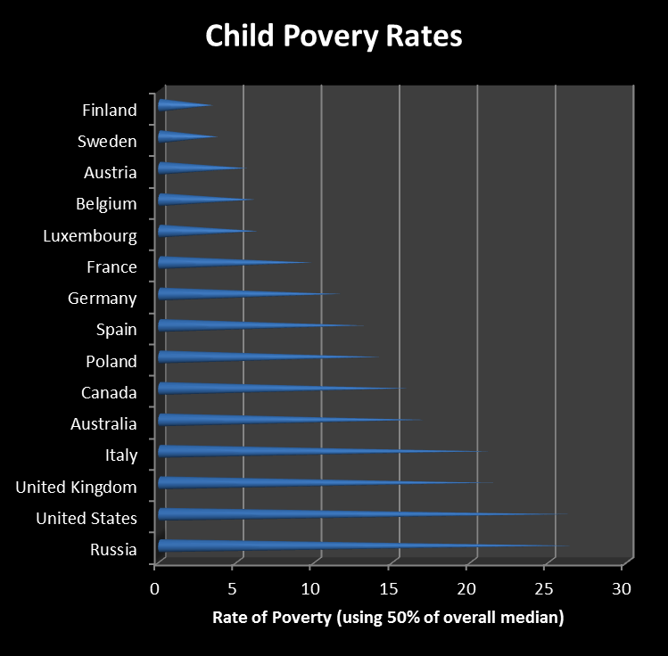
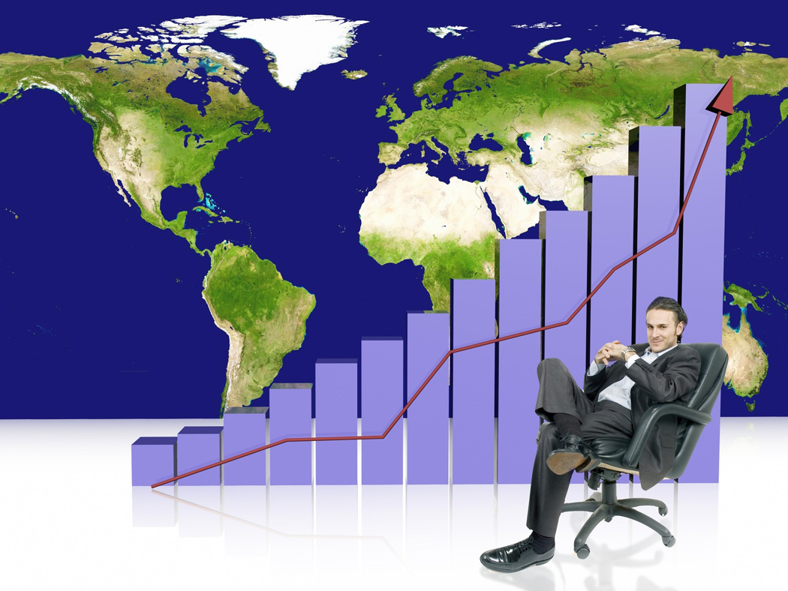
In regards to Poverty, how does the United States rate?

Slide 5

If America Has So Much, Why is There So Much Poverty?
There are some conflicting ideas to why poverty exists. Some say that people chose their path and that path leads to poverty. As a person is presented with choices, some choose so badly that they end up destitute. Others would argue that it is a problem of society. As a society grows and advances, some people just cannot adapt and are simple left behind.
*Glasmeier

Slide 6
How did We Get Here?
Before 1920, the causes of poverty were not explored but it should be noted that most of the poverty stricken were living in rural areas. The 1930’s brought about the depression and those poor folks who maintained family farms were no longer able to do so. It was because of this fact that people started to move to more industrialized areas. This forced those who were afflicted with such dire straights to be acknowledged. Population growth also added to the increasing numbers. There was competition for jobs and for resources. The government attempted to combat this by developing projects that would, in turn, create jobs for the thousands that found themselves displaced. However, poverty was not just a result of job scarcity. It was also a result of low incomes and long standing poverty levels. Some would argue that poverty was the result of laziness, this caused people to become far less charitable. Poor people choose to be poor and it within their power to control their fates, this was and still is theme among most of society. Another way that the government tried to combat poverty was by establishing a minimum wage and by instituting other government assistance programs. These things helped for a while but what happened was government jobs were not sustainable nor was assistance. When the United States entered WWII, the poverty stricken society did enjoy some relief. However, this relief did not last. Why is that?
*Glassmeier

Slide 7
Why Does Poverty Still Exist?
Increase in the elderly population
Increase in disabled citizens
Increase in children
Increase in immigration
Depletion of natural resources
Economic collapse
*Glasmeier

Slide 8

Who Does Poverty Affect the Most in The United States?
Poverty is an issue for all races. Several studies have been performed and reveal that every ethnicity has a percentage of it’s group that struggles with poverty. We know that children and elderly populations are two groups that the most effected by poverty. However, other minority groups like African American and Hispanic groups also have high rates of poverty.

Slide 9
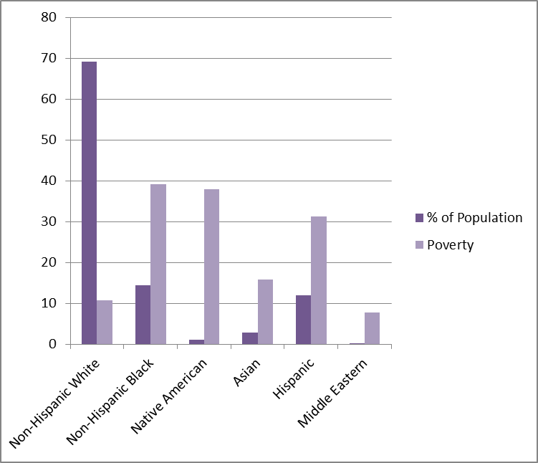
What Race is Most Likely to Experience Poverty?
This graph shows the major ethnic groups in the United State as a percentage. It also demonstrates what percentage of that particular race group is living under the poverty level.

Slide 10


There are also studies that show that married couples are less likely to experience poverty than families with single parents.
It also demonstrates that African American, Hispanic American and Asian American single mothers are more likely to live under the poverty level.

Slide 11

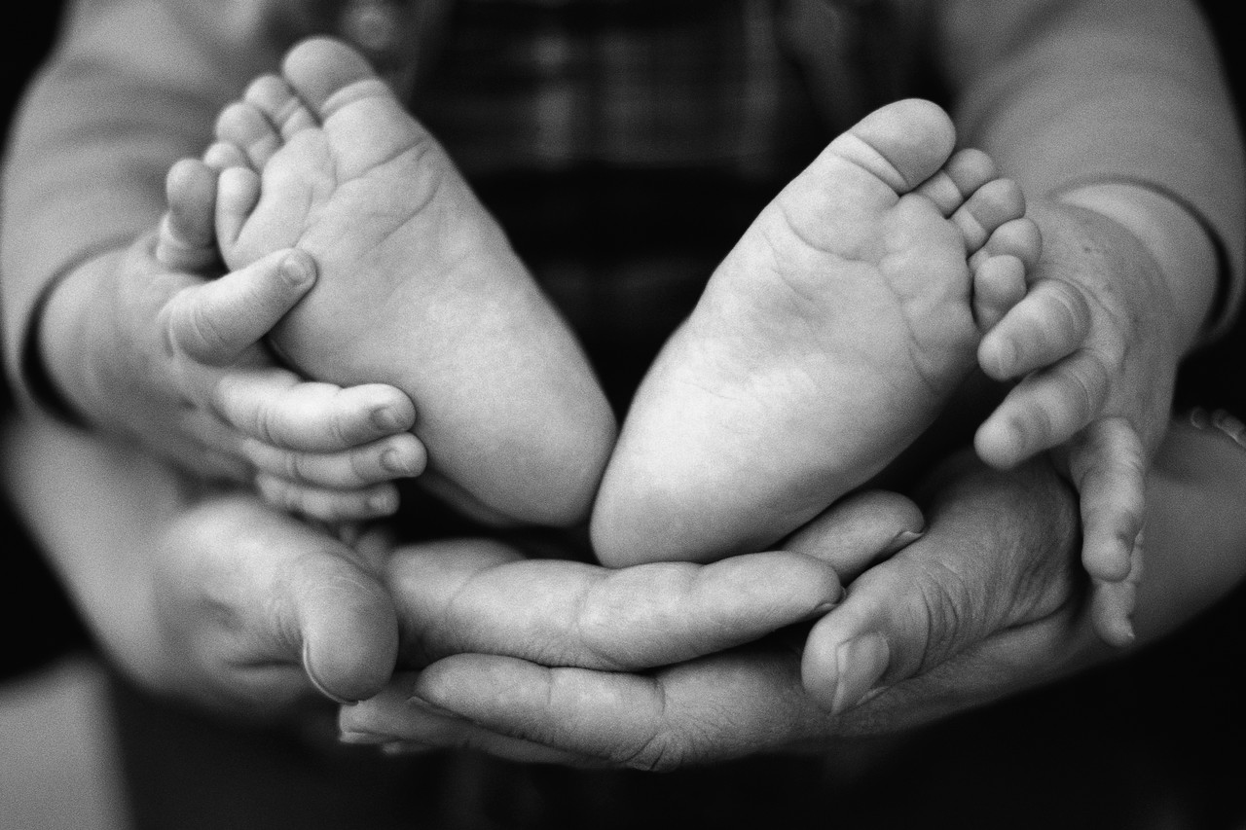
Who is More at Risk: Married Couples or Single Parents?

Slide 12
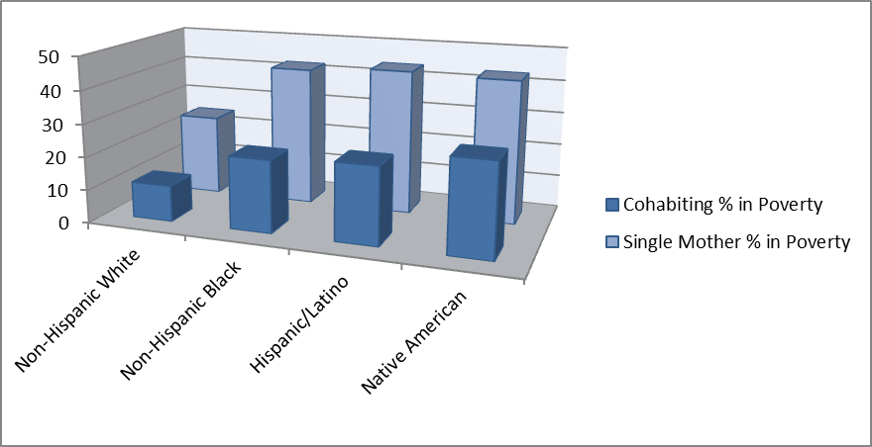
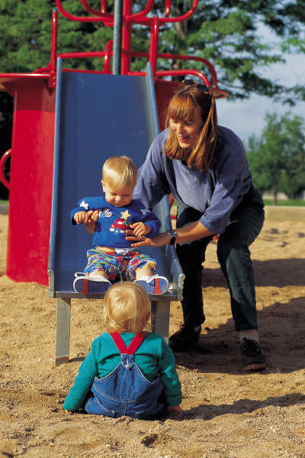
Single mothers: Which race is most likely to live below the poverty level?

Slide 13
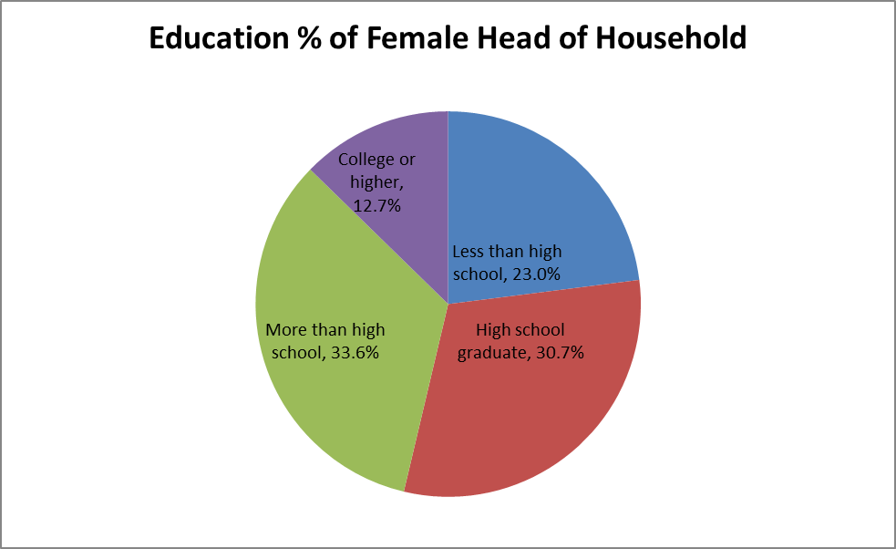
Further Studies also reveals that if a single mother has a higher level of education then poverty levels are lower.

Slide 14
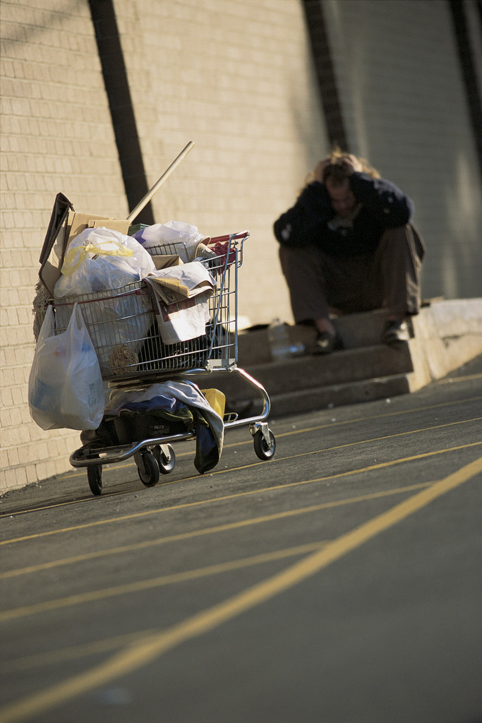
If a person is born into poverty, will they always live under the poverty level?
Does poverty beget poverty?

Slide 15
While some people do escape the poverty cycle, children of poor parents have a 16 to 28 percent probability of becoming poor adults. About 50% of those who escape the poverty of their parents end up with a net family income of less than twice the poverty line.
* Rodgers

Slide 16
How Can Poverty Affect People?
Poverty has been linked to poor academic performance. Children who come from a poor economic status have lower test scores and higher drop out rates than children who come from middle class and wealthy families. Even though some can escape a life of poverty, the truth is many will end up living under the poverty line. Furthering one’s education is one way for people to break free from poverty’s grip. Government programs have been established to help combat this phenomenon. However, teachers involved with these programs can see where they are not working. These children need custom programs to help them with their various learning difficulties.

Slide 17
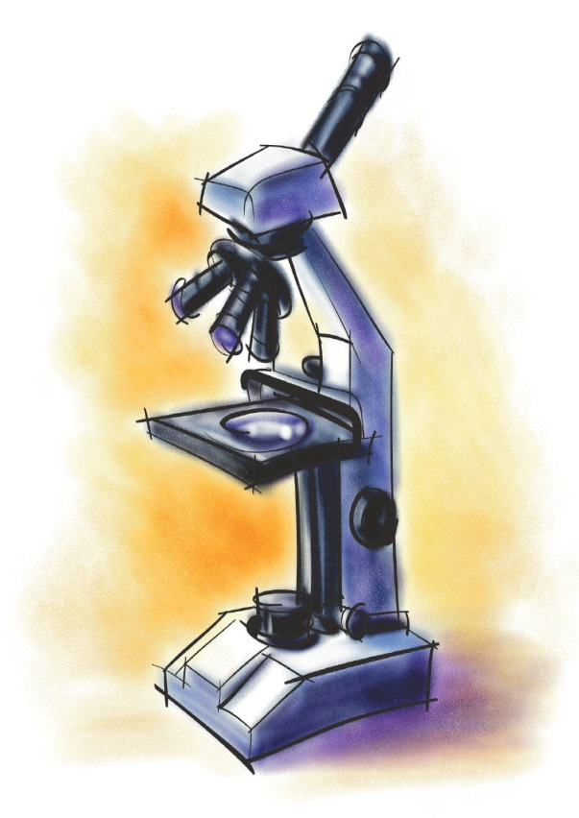
After the government instituted the No Child Left Behind act, as study was performed in low economic school districts to evaluate the efficacy of the reading portion of this program. The teachers were asked to evaluate the students performances and to evaluate the overall program.

Slide 18

“We are trying to create a miracle!”
Findings
“It seems like all we ever do is sounds, sounds, sounds.”
“Shouldn’t the children learn to read the words I and am before they’re expected to read I’m?”
‘How are they suppose to expand their vocabularies if all they ever see are the Read Well books?”
“Some of my kids just give up and start flipping through pages to look at pictures.”
“I spend most of my time moving their little fingers to the right space on the page.”

Slide 19

This group of teachers expressed their frustration with the program. Children were not comprehending the material that was being presented, so one teacher modified the program to increase comprehension. Many teachers abandoned portions of the program while adding other elements to the program. The teachers found that they had better results if they could tailor the programs to meet the needs of the children.

Slide 20
Poverty’s impact on Education
Children exhibit ADHD type behaviors. They cannot sit still. They are bouncing off the walls.
One teacher describes her students as being “angry and jaded.”
“A great deal of time is spent on redirecting students’ attention.”
Children often talked about the violence they witnessed in their communities, relaying stories of shootings, gang violence and arrests. Many children had at least one family member in prison. “My children are old before their time,” one teacher noted.
It takes a few minutes to get the children to settle down and ready to learn. They come in with a chip on their should, ready to argue.
It just drains your energy.
“I am trying to teach these children to read and they’re trying to survive!”

Slide 21
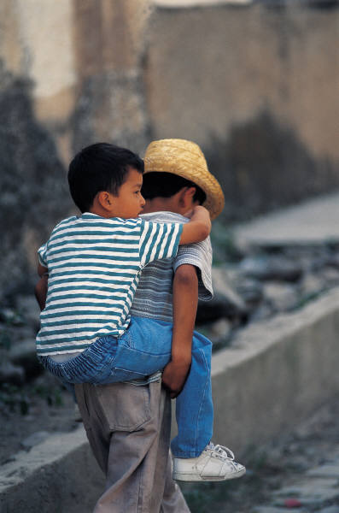
Other Effects of Poverty
Poverty affects education in other ways as well. These teachers reported that there were high rates of abscesses and transiency. Some children did not seem to have a permanent residence and most of these children were dependent on the school’s breakfast/lunch program for nutrition. Many children live in overcrowded homes where they were responsible for younger siblings. They often miss out on much need sleep and study time. They also do not have access to adequate health and dental care. All these things make it even more difficult for poverty stricken children to learn and perform well in school. “It is the children who struggle the most who miss the most school,” one teacher noted.

Slide 22
There are Still Some Things That I Just Don’t Understand
Why does it seem that there is so little focus placed on rectifying this problem with poverty? It seems that there is plenty to go around.
How does the problem get solved? Is it a matter of creating more jobs? Does there need to be more government assistance? How will these programs be funded? Can this problem even be solved? Is it simply a matter of money?

Slide 23

Final Thoughts
I don’t know if this problem with poverty will ever be solved. I see this enormous problem with it’s devastating effects and I just don’t know how it will ever be remedied. It seems so daunting and overwhelming. I know that we can’t give in. I know that we can’t give up. We have to keep trying. We have to keep caring about our fellow man. We, as a nation, cannot let this problem conquer us. We live in the land of plenty and we need to devise a way to reach those who are less fortunate. I believe that education is one of the keys to abolishing poverty but I don’t think that the current government established programs are working. I wish that I had all the answers. I wish I could magically fix all the problems in the world. In the mean time I will continue to do what I can.

Slide 24
References
Bradbury, Bruce. "Child Poverty Across the Industrialised World." Family Matters Spring/Summer.54 (1999): 65-69. Web. 10 Mar. 2013. <http://web.ebscohost.com.dbprox.slcc.edu/ehost/detail?vid=13&sid=59f2885e-1c7c-4028-ad5e-01e89c1dbb02%40sessionmgr114&hid=128&bdata=JnNpdGU9ZWhvc3QtbGl2ZQ%3d%3d#db=aph&AN=2676472>.
Duncan Owens, Deborah. "Commercial Reading Programmes as the Solution for Children Living in Poverty." Literacy 44.3 (2010): 112-21. Web. 10 Mar. 2013. <http://web.ebscohost.com.dbprox.slcc.edu/ehost/detail?sid=d279df9d-4b1e-4cce-95f3-50d51a52c5f5%40sessionmgr110&vid=1&hid=128&bdata=JnNpdGU9ZWhvc3QtbGl2ZQ%3d%3d>.
Lichter, Daniel T., Zhenchao Qian, and Martha L. Crowley. "Child Poverty Among Racial Minorities and Immigrants: Explaining Trends and Differentials*." Social Science Quarterly 86.S1 (2005): 1037-059. Academic Search Premier. Web. 10 Mar. 2013. <http://web.ebscohost.com.dbprox.slcc.edu/ehost/detail?vid=4&sid=d279df9d-4b1e-4cce-95f3-50d51a52c5f5%40sessionmgr110&hid=128&bdata=JnNpdGU9ZWhvc3QtbGl2ZQ%3d%3d#db=aph&AN=19493497>.
Rogers, Joan R. "An Empirical Study of Intergenerational Transmission of Poverty in the United States*." Social Science Quarterly 76.1 (1995): 178-94. Academic Search Premier. Web. 10 Mar. 2013. <http://web.ebscohost.com.dbprox.slcc.edu/ehost/detail?sid=964f6008-5dd4-4233-8202-2772791cfa14%40sessionmgr111&vid=1&hid=128&bdata=JnNpdGU9ZWhvc3QtbGl2ZQ%3d%3d#db=aph&AN=9504181516>.
Snyder, Anastasia R., Diane K. McLaughlin, and Jill Finderis. "Household Composition and Poverty among Female-Headed Households with Children: Differences by Race and Residence*." Rural Sociology 71.4 (2006): 597-624. Academic Search Premier. Web. 10 Mar. 2013. <http://web.ebscohost.com.dbprox.slcc.edu/ehost/detail?vid=6&sid=d279df9d-4b1e-4cce-95f3-50d51a52c5f5%40sessionmgr110&hid=128&bdata=JnNpdGU9ZWhvc3QtbGl2ZQ%3d%3d#db=aph&AN=23181128>.

