Slide 1
Hope for the Future
Relationships after Cancer Treatments

Slide 2
By Amanda Staker Shirts
Professor Cathy Carey
FHS 2450: Human Sexuality
November 15, 2012

Slide 3
The Importance of Sex
Sex and Sexuality are common aspects of everyday life. As stated by The American Cancer Society, “Feelings about sexuality affect our zest for living, our self image, and our relationships with others.”

Slide 4

How Treatments Can Effect a Woman’s Sexuality
The type of treatment a woman chooses to manage her cancer can have a variety of effects on her sexuality. Surgery can cause pain issues, appearance changes, and premature menopause. If chemotherapy and/or radiation are chosen, there can be loss of energy, decreased libido and body image disturbances.

Slide 5
Common Surgeries That Can Cause Sexual Problems
Pelvic Surgeries
Breast Surgeries
Hysterectomy
Radical Hysterectomy
Bilateral Salpingo-Oophorectomy
Oophorectomy
Vulvectomy
Cystectomy
Radical Cystectomy
Bowel Surgery with Ostomy
Total Pelvic Exenteration
Mastectomy
Bilateral Mastectomy
Bilateral Radical Mastectomy
TRAM Flap Reconstruction
Latissimus Flap Reconstruction

Slide 6

How Can Chemotherapy and Radiation affect My Sex Life?
Chemotherapy can cause a person to become weak, nauseated, and lose weight. There can also be significant hair loss and these changes can be devastating to a woman. Radiation can cause pain, burns and fatigue. While a woman is undergoing chemotherapy and/or radiation treatments, a doctor should be consulted about the patient’s ability to have sex.

Slide 7
Common Questions asked by Women
What is a normal sex life?
Will I still be able to have children?
Will my partner still want me?
Will I function normally after treatment?
How will sex be different after treatment?
Can I have sex during treatment?

Slide 8

What is a normal sex life?
While “normal” is a relative term, a normal sex life consist of whatever gives you and your partner pleasure. It is something that both partners should agree upon. This “normal sex life” can be redefined as the couple ages or as health issues impact a couple’s situation.

Slide 9

How will Sex be different after surgery?
Certain surgeries can cause different changes within a woman’s body. With removal of ovaries, a woman can be forced into early menopause. This can bring about vaginal dryness and decreased libido. There are several brands of lubricants that be used on a daily basis and during intercourse. Hormone replacement therapy might also be an option and should be discussed with a physician. For surgeries that cause changes in appearance, like a cystectomy, sex might be more difficult but not impossible. A woman must feel comfortable with the changes in her body in order to feel desirable. This takes patience, support and understanding from the woman’s partner for the woman to overcome these changes. Counseling and therapy might also be appropriate in order to establish a new sexual relationship.

Slide 10
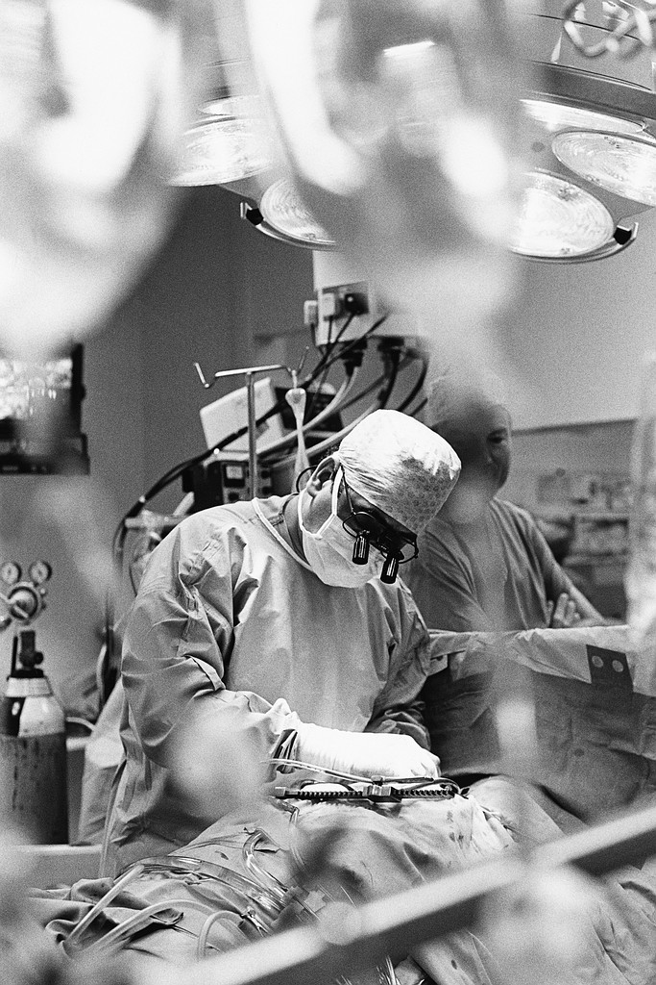
Will I Function Normally after Surgery?
While most surgeries won’t interfere with sexual function, there is a psychological aspect that might be an issue. Surgical changes to a woman’s body might cause some image disturbances that make her feel insecure. It is important to allow time for healing, grieving and accepting of the situation.

Slide 11
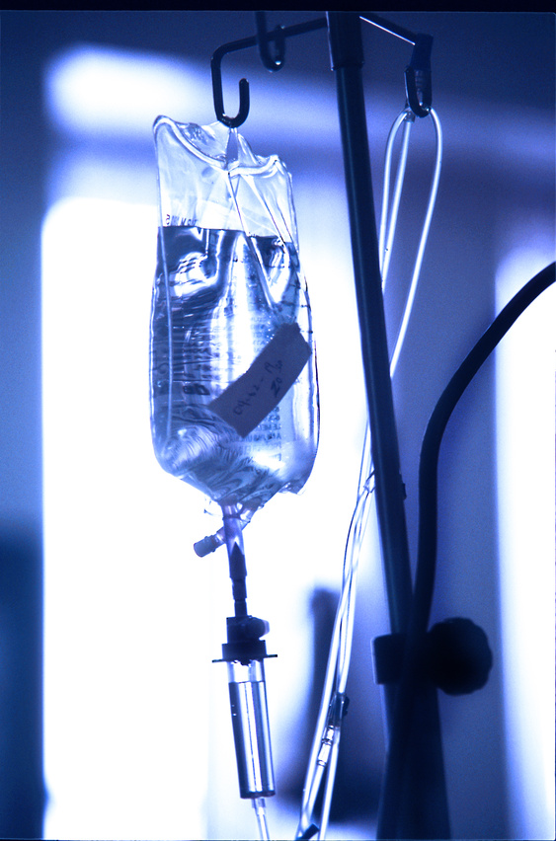
Can I Have Sex During Treatment?
With regard to pelvic surgery, sex will have to be postponed until the body had healed. This time frame is usually between 6 to 8 weeks. Before sexual activity is engaged in, a physician should be consulted. With breast surgery, there should be time allowed for healing but it will depend on pain issues and the woman’s comfort with her body. Again, there is an adjustment period that should be observed. When chemotherapy is the course of action, sexual activity will depend on the types of medication is used. Most medications do no affect vaginal secretions, but there could be traces of the chemotherapy. Again, consulting a doctor should be consulted and the woman’s comfort, energy level, and over all health need to be taken into consideration. Radiation therapy is usually the least invasive and traumatic. As noted above, consult a doctor and be mindful of the women’s health status.

Slide 12
Will I still be able to have children?
Surgeries
Chemotherapy and Radiation
Depending on the type of pelvic surgery, a woman may not be able to achieve a pregnancy. Prior to surgery, there are methods of egg retrieval and preservation that could be an option. Breast surgeries are often accompanied by oral chemotherapy, therefore, it might be dangerous to become pregnant. In this case, egg preservation would be an option. In all cases, discuss these options with a physician.
During treatment with chemotherapy drugs, a pregnancy should not be attempted because of the danger to the baby. Chemotherapy can cause significant changes to a woman’s body, please consult a doctor about these effects and if a pregnancy should be attempted. However, egg preservation is an option prior to treatment. In regards to radiation, there can be extensive tissue damage that may impair a pregnancy. This should also be review with the oncologist.

Slide 13
Methods of Preservation and Other Options for Pregnancy
Embryo Freezing
Egg Freezing
Ovarian Tissue Freezing
Ovarian Suppression
Fertility-Sparing Surgery
Ovarian Transposition
Ovarian Shielding
Other methods of having a child include surrogacy, adoption, in-vitro fertilization, and egg donation. While these may not be the ideal method to have a child, they do offer hope for the future.

Slide 14

Will My Partner Still Want Me?
With all the questions that surround cancer treatment, this is perhaps the most crucial question for women to have answered. With all the possible changes that a woman might undergo, women might fear that they will be unattractive to their partners. There are things a couple can work on to help maintain the intimacy between them. It is important to make time to just be a couple. While the main focus becomes treatment, it is important that time is made to connect with each other. This can include embracing, caressing, cuddling, and touching each other. This touching does not have to include intimate touching. Each person needs to have an opened mind about what intimacy includes. Each person needs to be willing to explore other forms of sexual pleasure and intimacy, as well.
In some cases, counseling and couple’s therapy might be needed. Especially in cases where there are extreme body changes, a couple might need support in maintaining an a sexual relationship. As always, communication is a key technique in sustaining a sexual relationship during treatment.

Slide 15
It is important to remember while undergoing treatment, that the patient needs support as well as the patient’s partner. The couple is under tremendous pressure and it is so important that the couple remain connected in all ways: body, mind and spirit.

Slide 16

How Are Men Effected By Treatment?
Men can have similar effects to women, depending on the treatment. Surgeries can cause loss of sensation, pain and body image issues. Chemotherapy and Radiation can cause nausea, fatigue and decreased libido.

Slide 17
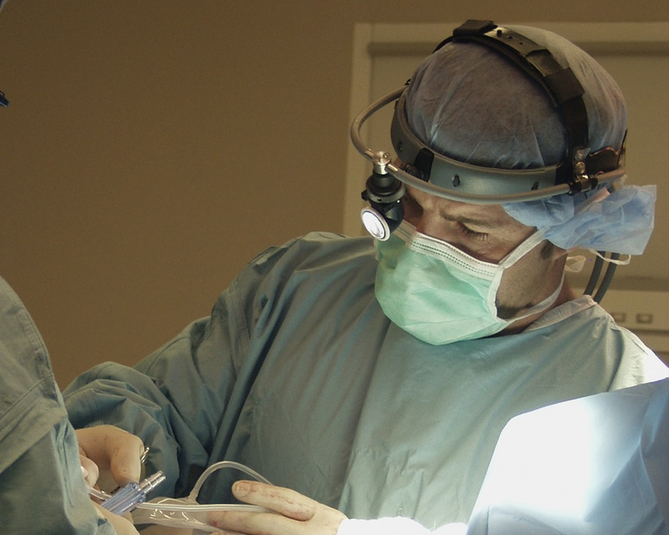
Common Surgeries That Can Effect Sexual Function
Retroperitoneal lymph node dissection
Bowel surgeries with ostomy
Radical Prostatectomy
Radical Cystectomy
Total Pelvic Exenteration
Partial Penectomy
Total Penectomy
Orchiectomy
Bilateral Orchiectomy

Slide 18

Chemotherapy and Radiation
While is can be assumed that surgeries will cause problems with sexual function, chemotherapy and radiation can also cause issues. While it is rare, chemotherapy can cause erectile dysfunction, infertility, and decreased sexual desire. Radiation, because it can cause nerve and tissue damage, can cause problems with erections, infertility, and weaker orgasms.

Slide 19
Common Question asked by Men
Can I Still Have Sex During Treatment?
How Will I Look After Treatment?
Will I Still Be Able To Function Normally After Treatment?
Will My Partner Still Want Me After Treatment?
After Treatment, Will It Be Possible For Me To Have Children?

Slide 20
Will I Be Able to Have Sex During Treatment?
Surgery
Chemotherapy and Radiation
Sex immediately following surgery is not usually recommended. The body needs time to heal, typically 6 to 8 weeks. Once the surgeon has determined that a wound is healed, then sexual activities can be resumed.
Most Chemotherapy drugs are not excreted in seminal fluids. Therefore, sexual activity is not prohibited. However, checking with an oncologist before having sex is always recommended. The same advice is given for radiation treatments.

Slide 21

Will I Still Be Able to Function Normally After Treatment?
Most surgeries require a healing period and won’t interfere with sexual function. However, there could be some nerve dysfunction that may be permanent or temporary. This nerve dysfunction could range from decreased sensation to erectile disorders. There are options if this occurs, so be willing to discuss any complications with a physician. In regards to chemotherapy and radiation treatment, sexual problems are rare but not completely uncommon. Again, keeping an open dialogue with the health care professionals can offer up solutions.

Slide 22

How Will I Look After Treatment?
Chemotherapy and radiation have little effect on appearance, but surgery can dramatically alter appearance. If body is dramatically altered, there area options that can be explored. Plastic surgery has helped to improve body appearances and function after disfiguring surgeries. There are also surgical options to help restore function. These surgeries can range from nerve restoration to implants. Before deciding on a course of restoration surgery, consult a plastic surgeon.
If restoration surgery is not an option, counseling
and therapy might be needed to cope with these
changes.

Slide 23

Will I Still Be Able To Have Children After Treatment?
Most surgeries, chemotherapy and radiation inhibit the ability to have children. So having children after treatment is facilitated by sperm salvage prior to treatment. These methods include freezing of semen and sperm, as well as freezing testicular tissue. If preservation is unable to be performed using these methods, sperm donation and banks pose another option. If these methods are undesirable to the patient, adoption is always an option. While these approaches may not be ideal, they do offer hope for the future.

Slide 24

Will My Partner Still Want Me?
Dealing with the diagnosis of cancer subjects a couple to tremendous pressures. Coping with the changes that can occur, presents a whole new set of challenges. That is why it is important for a couple, while undergoing treatment, to make time for intimacy. This intimacy doesn’t have to include sexual intercourse but should include embracing, touching, and sharing feelings and thought. This will help to ensure an intimate relationship after treatment. If a couple is experiencing difficulties in this area, enlisting the help of a therapist is recommended.

Slide 25

Types of Therapy Available
Sexual Rehabilitation Programs
Sexual Dysfunction Clinics
Sex Therapists
Psychotherapy

Slide 26


While cancer may alter things, it does not have to destroy all things. There is support available for all people who are effected by cancer. The American Cancer Society, The American Cancer Society Patient Navigator Program, Cancer Resource Centers, Cancer Survivors Network, Hope Lodge, I Can Hope, and Road to Recovery are just a few programs that can offer suggestion and support for treatments and after treatments.

Slide 27
A Special Thanks to the Following
Reference page
Cancer and Fertility. N.p.: Huntsman Cancer Institute, 2012. Print.
Fertile Hope: Fertility Resources for Cancer Patients and Survivors. Austin: Lance Armstrong Foundation, 2012. Print.
Managing Radiation Therapy Side Effects: What Men Can Do About Changes in Sexuality and Fertility. N.p.: National Cancer Institute, 2007. Print.
Managing Radiation Therapy Side Effects: What Women Can Do About Changes in Sexuality and Fertility. N.p.: National Cancer Institute, 2007. Print.
Schover, Leslie R., PhD, comp. Sexuality for the Man With Cancer. N.p.: American Cancer Society, 2006. Print.
Schover, Leslie R., PhD, comp. Sexuality for the Woman with Cancer. N.p.: American Cancer Society, 2011. Print.

