Slide 1
The ABC’s of ME
By
Amanda Staker Shirts

Slide 2
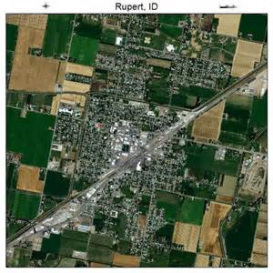
This is the little town of Rupert where my life started and is the place that I still call home.

Slide 3
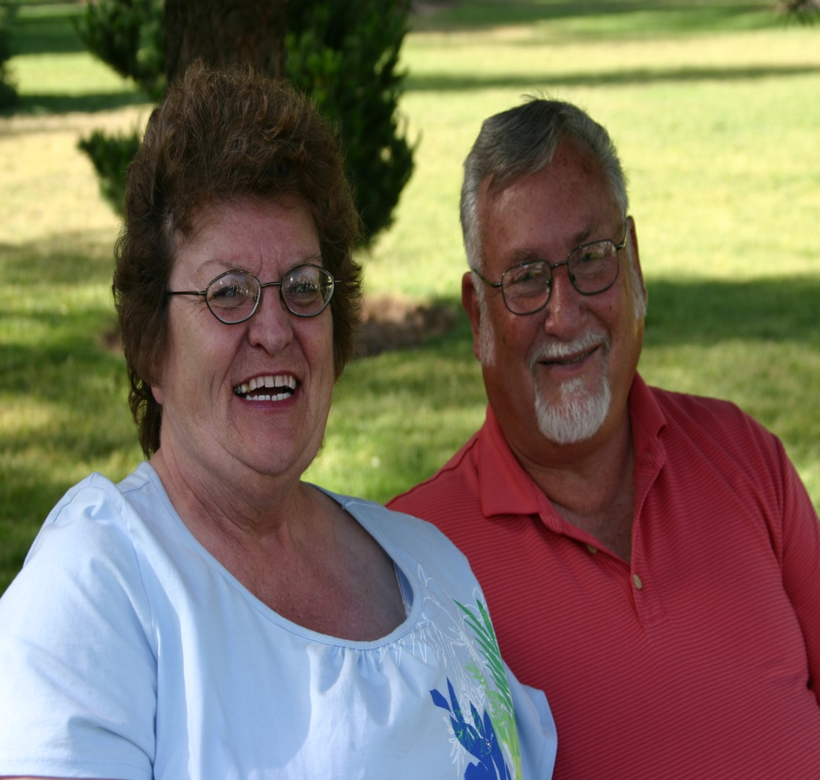
I am the daughter of Maury and Wendy Staker, who have been married for 40 years. They have lived most of their lives in Rupert . I grew up on a farm where we were expected to work hard but we also played hard.

Slide 4
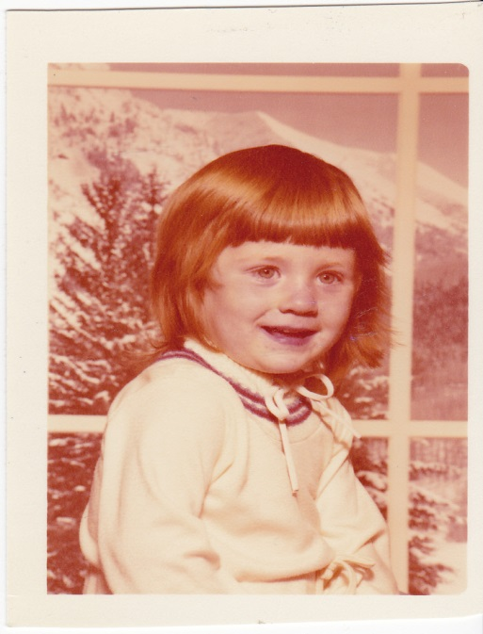
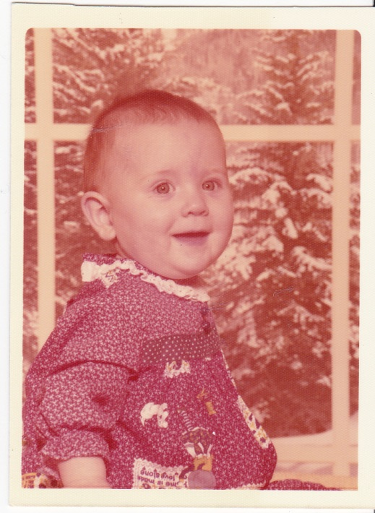
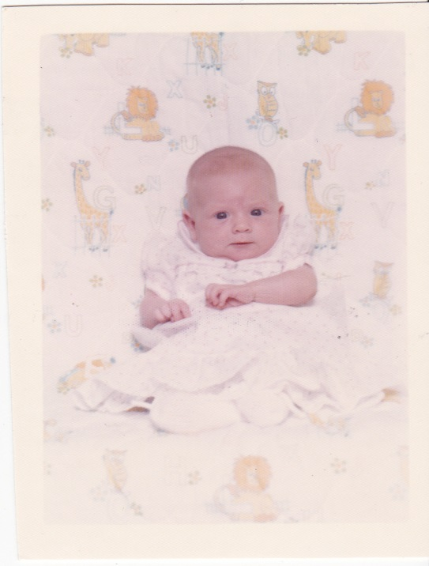
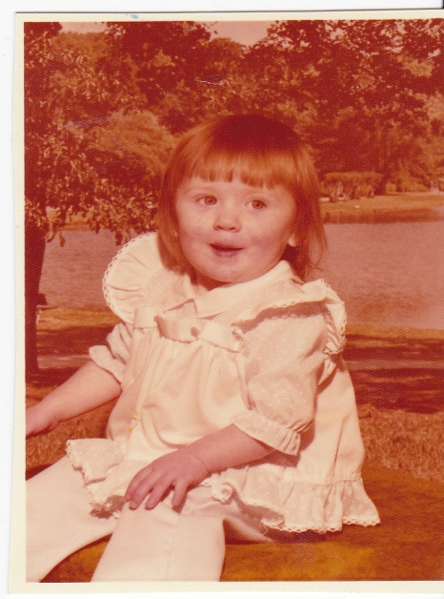
I was born on July 10, 1977 at 5:17pm. I am the only child in my family with red hair and green eyes.

Slide 5
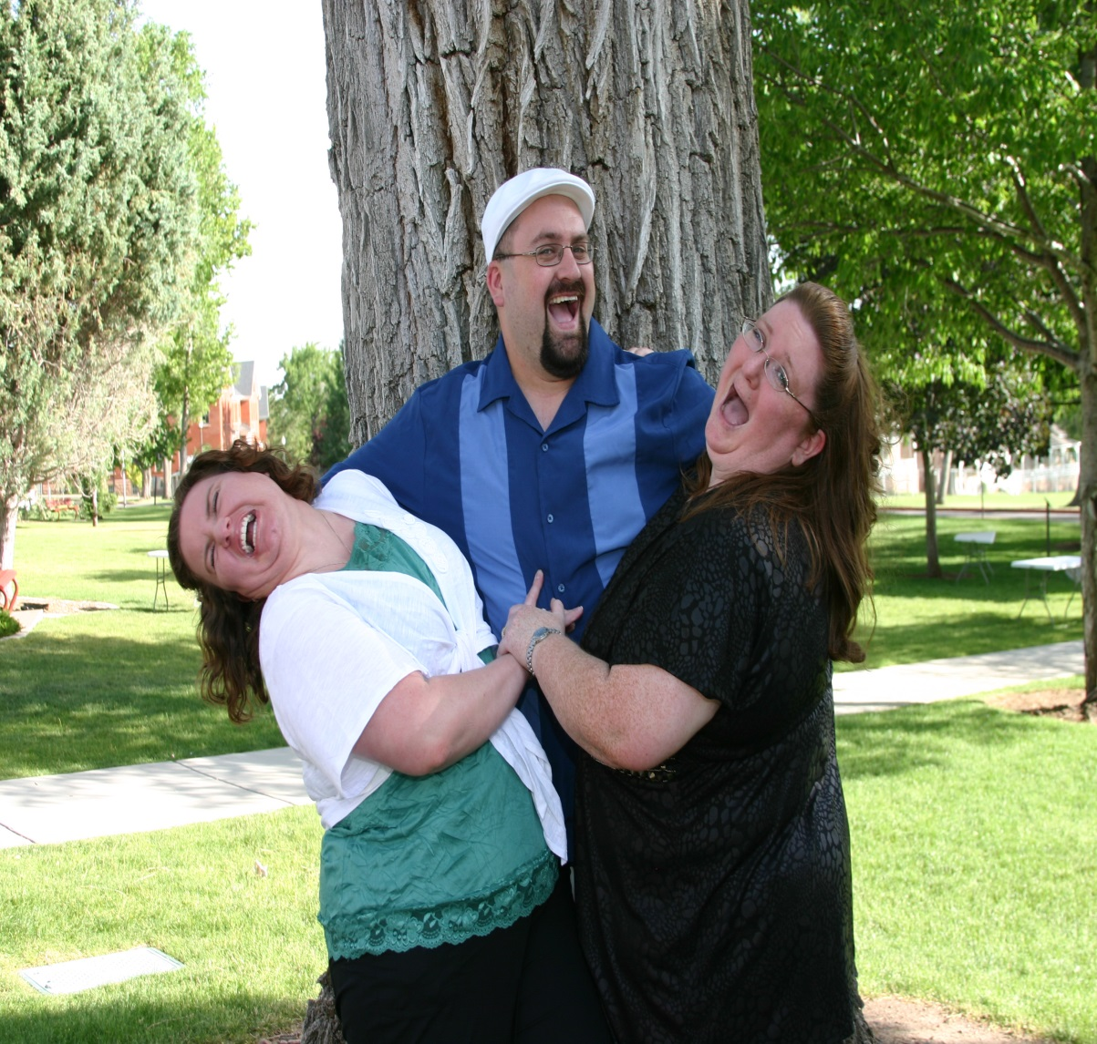
I am the second child of three children. My sister, Brandy( in the green)is the oldest. My brother, Adam is the youngest.

Slide 6
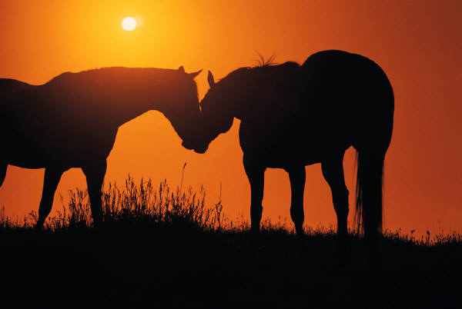
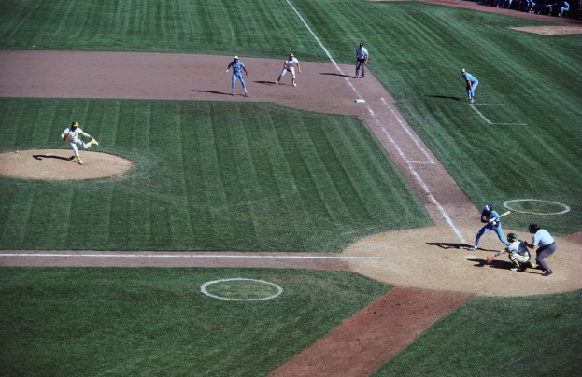
Some Strange Little Facts about my Childhood
I was run over by a 4th of July Parade float when I was 7.
I helped breed, birth and train my grandfather’s quarter horses.
I played volleyball from the time I was 8 years old until my senior year.
I have wreck more times on a snowmobile than I care to count, some were quite severe accidents, but I have never been seriously injured.
I used to jump off the roof my house and my father would catch me. I would just off of just about anything if I knew my father was going to catch me.
I was catcher for my softball team and was hit in the head with a bat. I also fell while rounding 3rd but still made a home run.

Slide 7
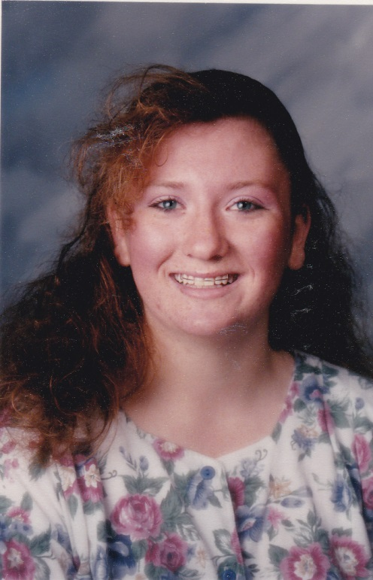
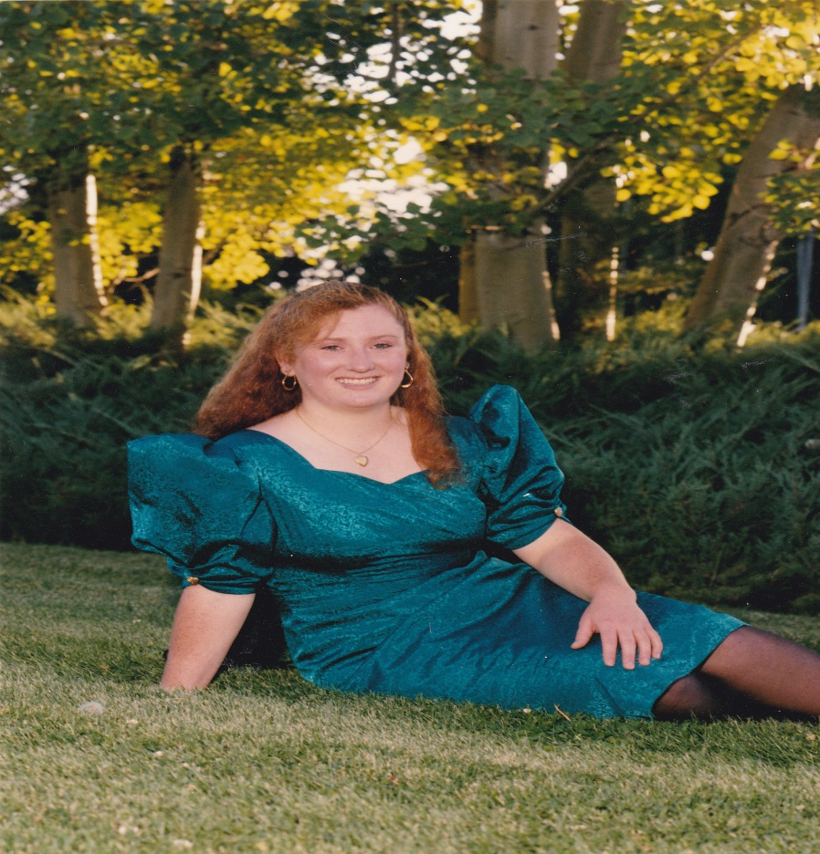

I graduated from Minico High School in 1995 and totally rocked the 90’s hairdo!
I graduated with high honors and then went to Idaho State University

Slide 8
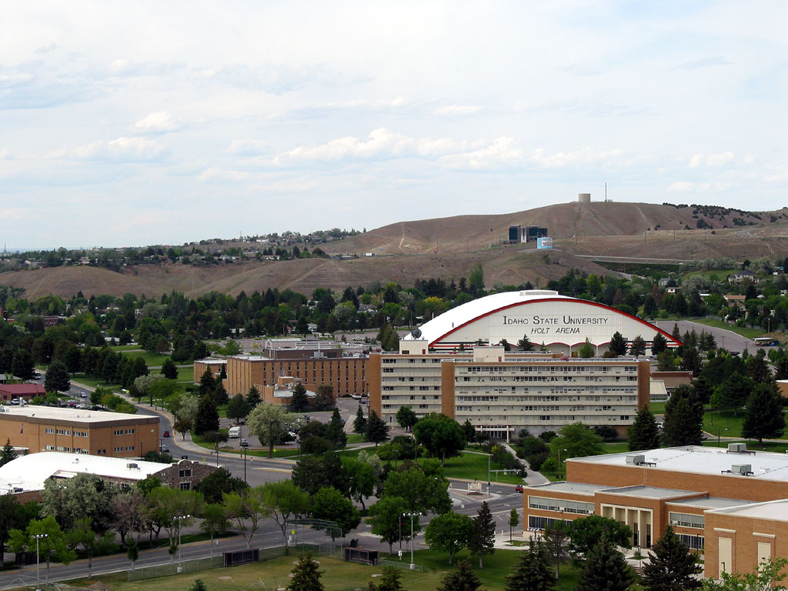
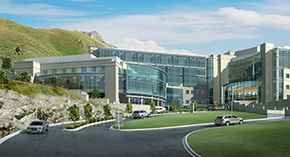
In 2001, I graduated from Idaho State University, became a Registered Nurses, and currently work at the Huntsman Cancer Hospital

Slide 9
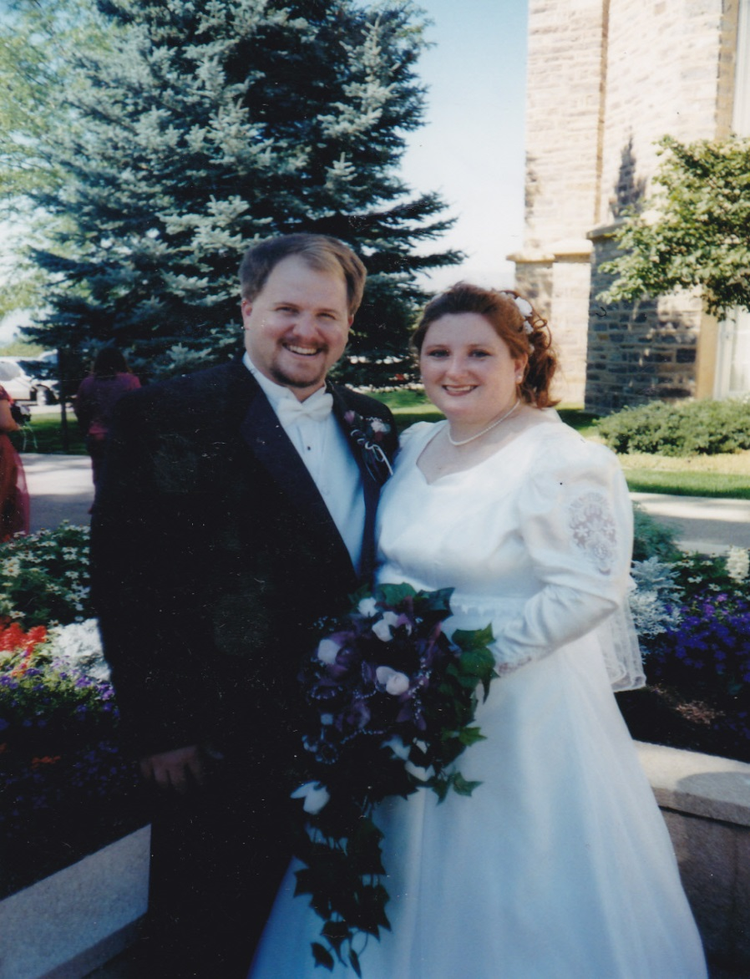
Amanda Jean got Married!!
I married John Michael Shirts on September 13, 2002. I purposefully chose a day that fell on Friday the 13th.

Slide 10
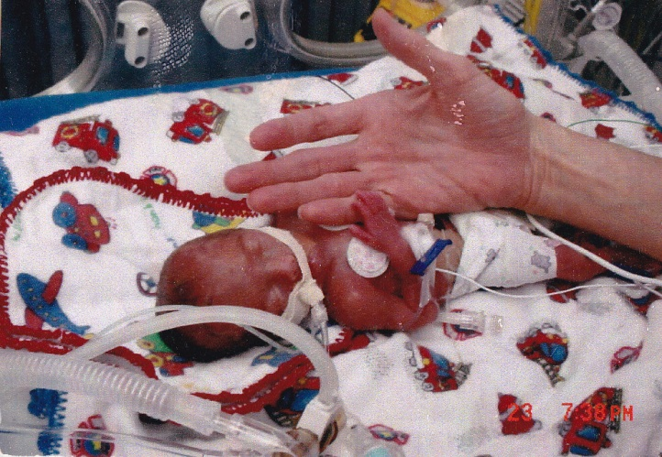
June 22, 2003: My World Changed
We were so excited to be expecting but during a routine ultrasound when I was 23 weeks along we found out there were complications. Apparently, I was trying to deliver my son. After only 4 days of bed rest, I gave birth to my son via emergent C-section. He weighed 1lb 10 oz. His skin was thin and fragile. His eyelids were still fused. The diapers that he wore were the size of a deck of cards. He spent 6 months in the ICU. He had his problems, he was a silent aspirator meaning he would “throw up into his lungs” after he ate. He had to have a surgery to correct this that left him with a feeding tube or g-tube.

Slide 11
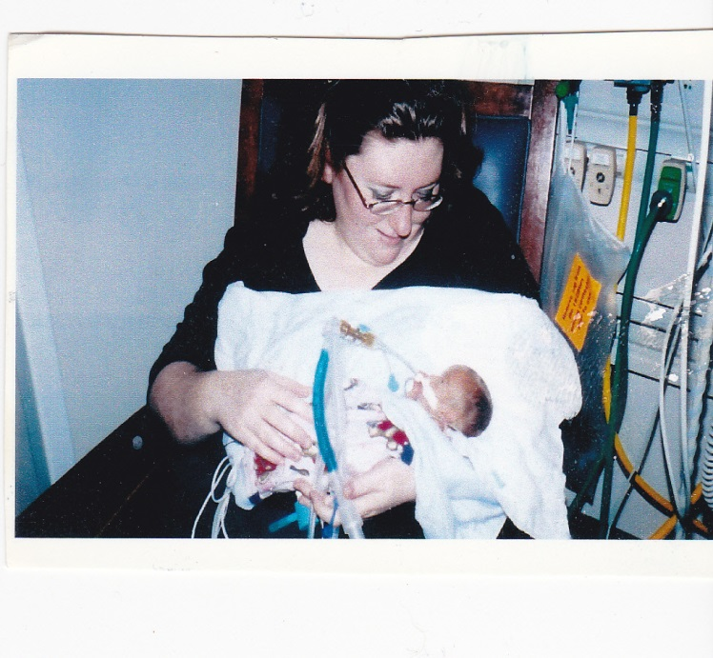
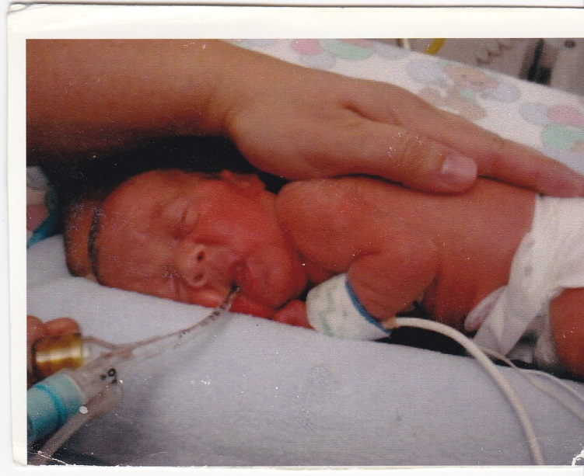
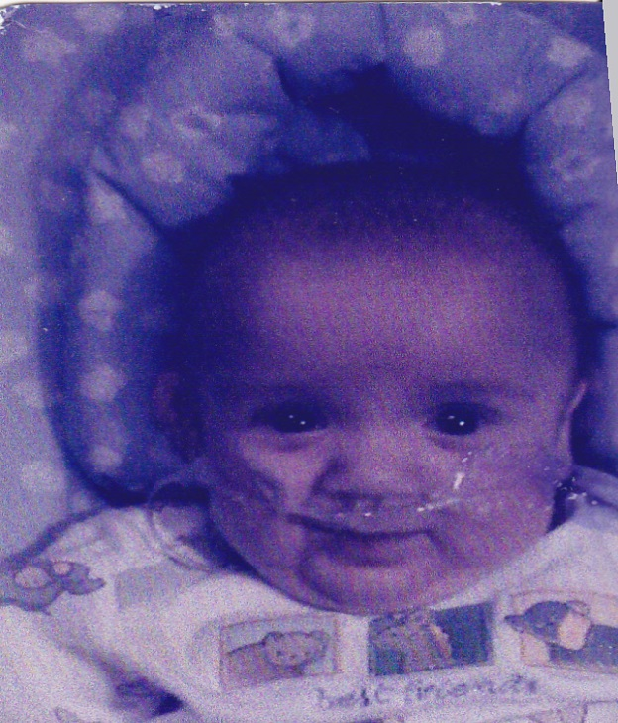
On July 10, 2003, two weeks after Joshua was born, I held him for the very first time.
Joshua Michael
Shirts
This is when we first brought him home in December 2003
This is the first time we ever saw his face without tape.

Slide 12
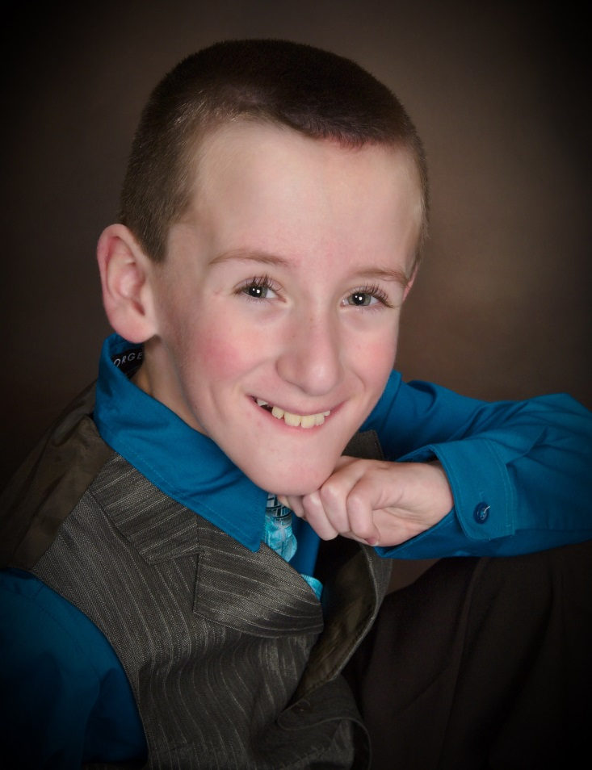
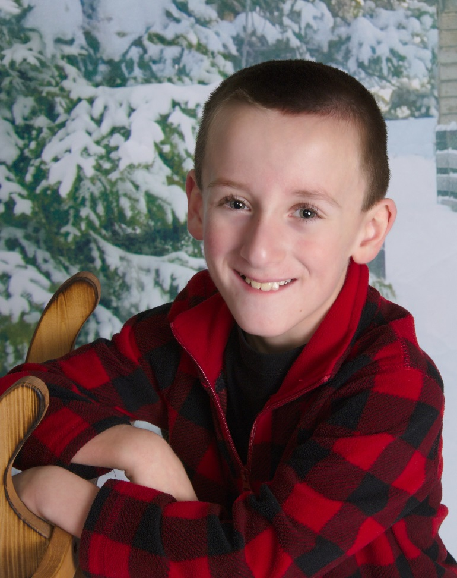
Ten years later, Joshua is doing very well and is the joy of our lives. He is smart, funny, happy and, most importantly, healthy.

Slide 13
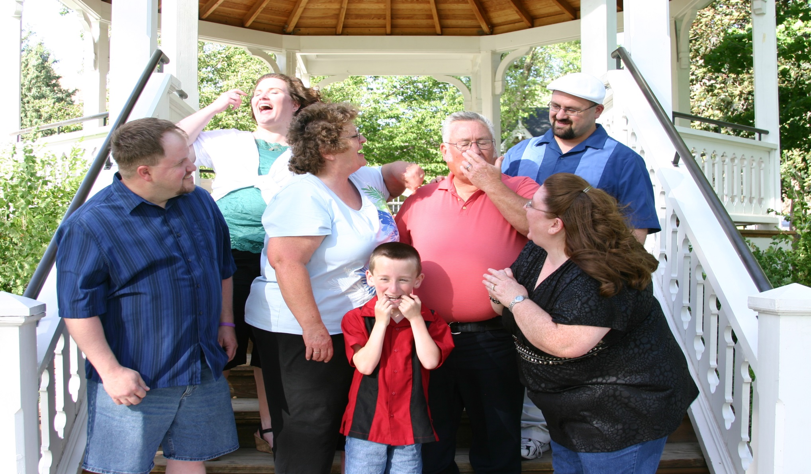
My Little, Imperfect Family

Slide 14
So this is a glimpse into my little world. It’s small and simple and uneventful. We live, we laugh, we love. But mostly, we are just… happy.

